Slide 1
I101 Group Project
Topic
Water Crisis in Sudan and South Sudan
-Shortage
-Purity
-Climate
-Tension
-Money
I101. Spring 2014
Group Members
Ahjin Kim
Bennett Dierkman
Conner Stevens
Enguunee byambadorj
Erik Townsman

Slide 2
Initial Problem
South Sudan, a new Country that gained its independence from Sudan in 2011, is experiencing a severe shortage of clean water. It has been reported by the Southern Sudanese government that as little as 50% of the population officially has access to an improved water source.
Our group specifically focused on the village of Abyei, a village very close to the border of Sudan and South Sudan, which is especially suffering. The problem actually effects most of the country. We chose this problem because we felt that technology could be used to solve it.

Slide 3
Currently
Currently, the Ministry of Water Resources within the government of Southern Sudan is responsible for officially working towards a solution.
Other countries, such as Germany, Japan, and the United States have donated external grants.
Non-profit organizations such as Water for South Sudan and The Water Project have been formed and are also currently sending money to the South Sudan government.

Slide 4
Scenario
A scenario that may help you relate would go as follows:
-Most of your days you cannot access clean drinking water. If you can access it, you may have to walk from Bloomington to Martinsville, and then bring it back. Most of the time you drink this water, you also feel sick afterwards and sometimes you contract diseases. There are also two warring parties that inhabit the space between Bloomington and Martinsville, so it’s rather unsafe to walk around in this area.

Slide 5
Underlying and Contributing issues
Sudan Armed Forces occupying the area
Citizens of Abyei must walk very far to access water, so although on paper they may seem to have access to clean water, it is still rather difficult for citizens to get to it
Citizens of South Sudan cannot access the closest and largest water source available, the White Nile, because the river dries up during the dry season, with the Egyptian government putting restrictions on access to those that are not Egyptian citizens.

Slide 6
Underlying and Contributing issues Continued
Only 7.3% of the water in rural areas is clean enough to drink
Only 15.8% of water in urban areas is clean enough to drink
45.8% of the population in South Sudan is between the ages of 0 and 14, children are more likely to contract the diseases found in water that is not pure

Slide 7
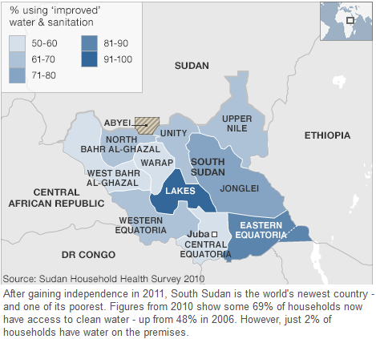
Data set

Slide 8
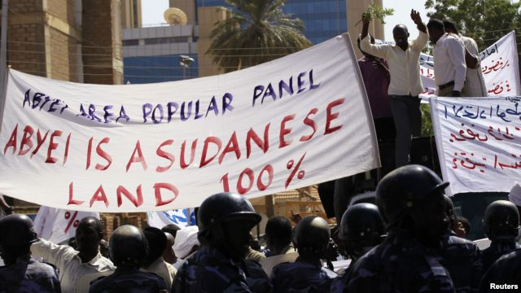
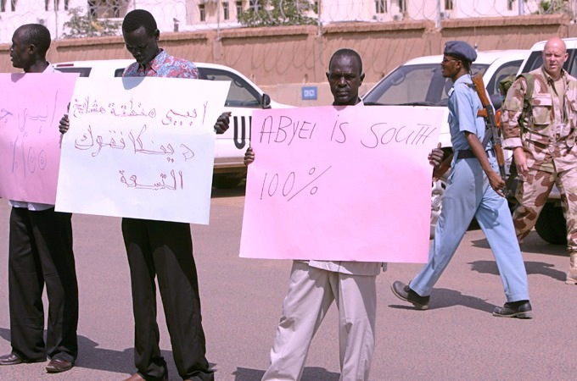
Abyei has been a region under conflict since the 1970’s
Sudanese protesters
South Sudanese protesters

Slide 9
Visualization
This visualization represents the percentage of water clean enough to drink in the Rural and Urban areas of South Sudan, as well as the national average. We also put the ideal average percent after the implementation of our solution.

Slide 10
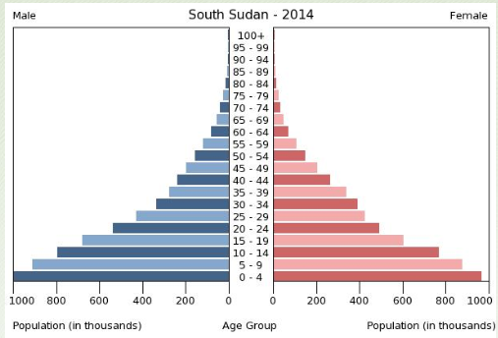
Visualization
45.8% of the population in South Sudan is between the ages of 0 and 14, which puts the main population at high risk for getting infected with various food and waterborne diseases.
Ages of 15-24 makeup 19.9% of the population, 25-54 makeup 29.1% and 55-64 year olds makeup 2.1% of the total population.

Slide 11
Our Solution
A piping system that transports water to wells and spigots closer to or inside Abyei and other villages with difficulty obtaining water, as well as purifying the water in the transportation process.
The water purifying irrigation system will reach different cities through underground pipe like structures that are designed to be built with purifying fibers among other agents that trap pathogens.

Slide 12
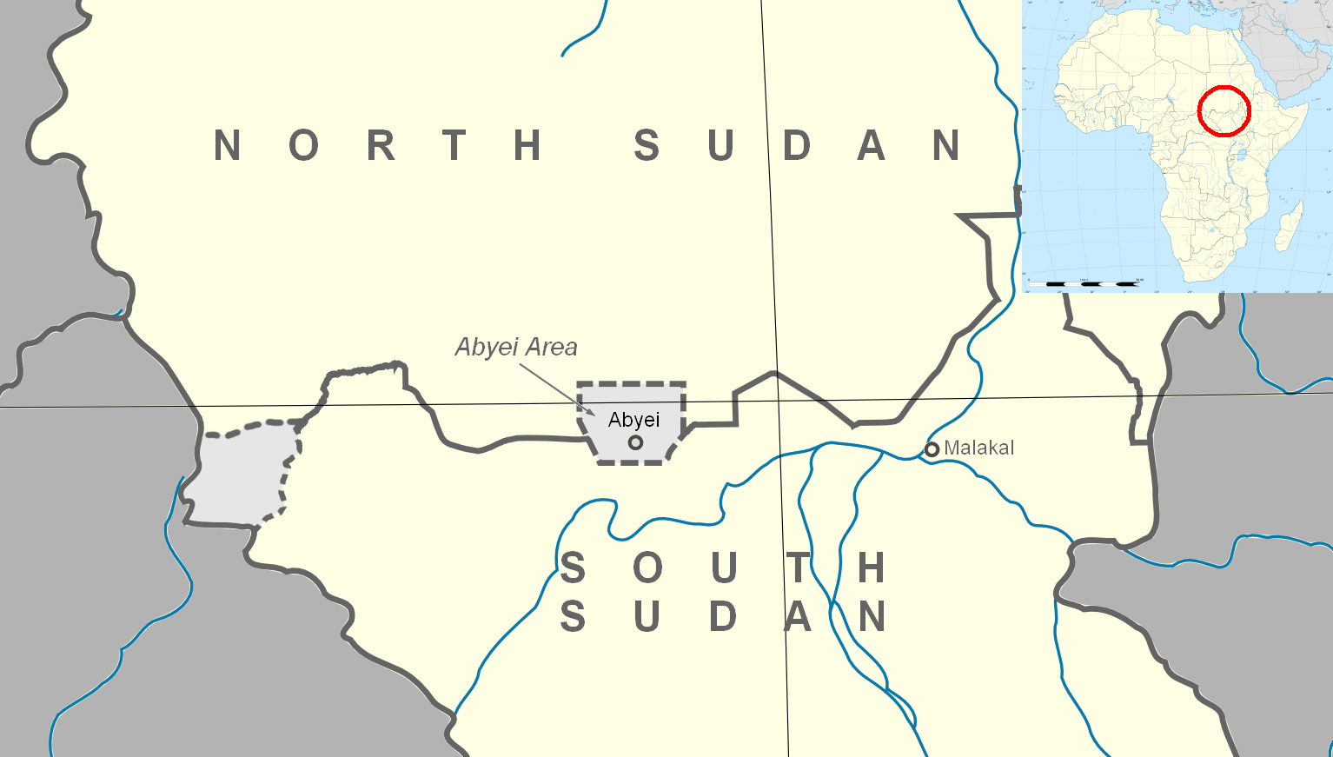
Geographical map

Slide 13
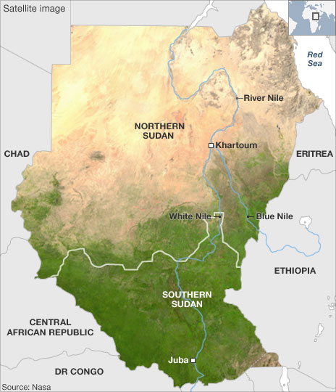
Geographical map

Slide 14
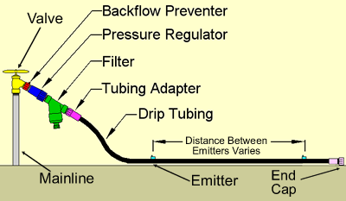
Simple diagram of Drip Irrigation system
For our solution, we plan to have a similar system for our spigots. Each spigot would be connected to a monitor that would display the current level of purity in the water being received, as well as a modifiable reception level. This would allow citizens to change the level of reception to fit their specific needs.
Water comes up here
Water comes out here

Slide 15
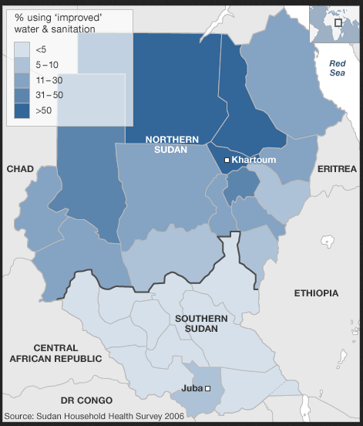
Data Set

Slide 16
Our Solution cont.
Our proposal is to modify a drip irrigation system and make a massive underground system that links the problem areas with access to water.
Each of these pipes will have a filtration system in them to purify the water while it is being transported and filter out the harmful chemicals.
In addition, each outlet will have a monitor hooked up so that the villages receiving water can modify the amount they are receiving depending upon the amount they need at that time. These monitors will also display the level of harmful chemicals in the water coming out of the spigot so that the villages will be notified when there is something wrong with the water they are receiving

Slide 17
Map of Water Transport system (detailed South Sudan)
-Water Spigots
Pipelines

Slide 18
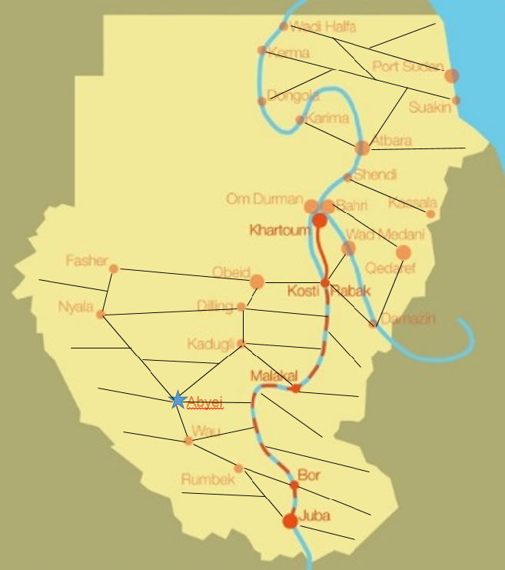
Map of Water Transport system (general, South Sudan and Sudan)

Slide 19
Visualization
This chart represents the overall population’s access to pure drinking water. Before our solution is implemented, the level of overall access is about 50%, afterwards it is moved up to about 90%. Although 100% would be ideal, it is not a realistic assumption. Our solution would make it much easier for the general population of South Sudan to access water, so much so that we set the level of access at 90%.

Slide 20
Works Cited
Admin. OnlyDailyNews.com. Only Daily News, 18 January 2014. Web. April, 2014.
Barton, Alexandra. "Water In Crisis - Spotlight Sudan." The Water Project. N.p., n.d. Web. 25 Apr. 2014.
Bucknall, Julia. Making the Most of Scarcity: Accountability for Better Water Management Results In the Middle East and North Africa. Washington, D.C.: World Bank, 2006.
Cia factbook. Central Intellegence Agency, April, 14, 2014. Web. April, 2014.
Korir, Sing. King, Laura. Land, Livleyhoods and identities: Inter community conflicts in East Africa. Minority Rights Group International, 2011. 10. Print.
"Lifestraw – The Lifestraw Portable Water Filter." Lifestraw ® – The Portable Water Filter. See the Lifestraw Here. N.p., n.d. Web. 23 Apr. 2014.
N.d. N.p.: n.p., n.d. N. pag. Web. <http://www.schrattenkalk.com/wordpress/wp-content/uploads/2010/03/sudan_map_nile.jpg>.
Ranganathan, Rupa, and Cecilia M. Briceño-Garmendia. Sudan's Infrastructure: A Continental Perspective. N.p.: n.p., n.d. Sept. 2011. Web. 9 Apr. 2014. <http://elibrary.worldbank.org/doi/pdf/10.1596/1813-9450-5815>.
Shelby, Jan. Hoffmann, Clemmens. Beyond scarcity: Rethinking water, climate change and conflict in the Sudans. Elsevier Ltd, 2014. Print.
"The World Fact Book." Central Intelligence Agency. Central Intelligence Agency, 14 Apr. 2014. Web. 24 Apr. 2014. <https://www.cia.gov/library/publications/the-world-factbook/geos/od.html>.
Vaughan, Christopher, Mareike Schomerus, and Lotje De Vries. The Borderlands of South Sudan. New York: Palgrave Macmillan, 2013. 46. Print.
"Water supply in South Sudan." Water supply in South Sudan. Wikipedia, 13 Feb 2014. Web. 11 Apr 2014. <http://en.wikipedia.org/wiki/Water_supply_in_South_Sudan>.

